Slide 1
Hospital Data (Breast Cancer, Birth/Death and Employees) Analysis Using SAS
Prepared by: Mir Fakhrul Hassan

Slide 2
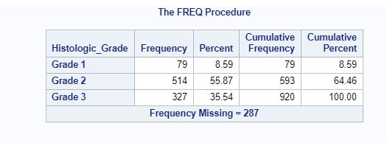
1. Frequency Distribution for Histologic Grade

Slide 3
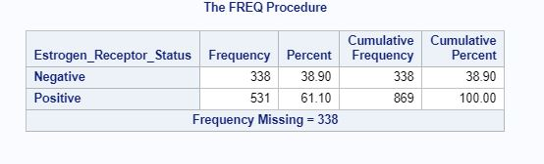
2. Frequency Distribution for Estrogen Receptor Status

Slide 4
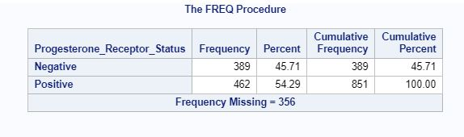
3. Frequency Distribution for Progesterone Receptor Status

Slide 5
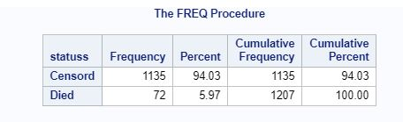
4. Frequency Distribution for Status

Slide 6
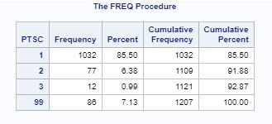
5. Frequency Distribution for PTSC

Slide 7
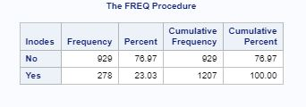
6. Frequency Distribution for LNODES

Slide 8
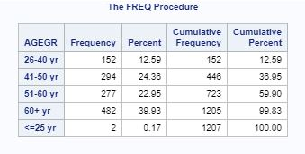
7. Frequency Distribution for AGEGR

Slide 9
8. Frequency Distribution for TMGR

Slide 10
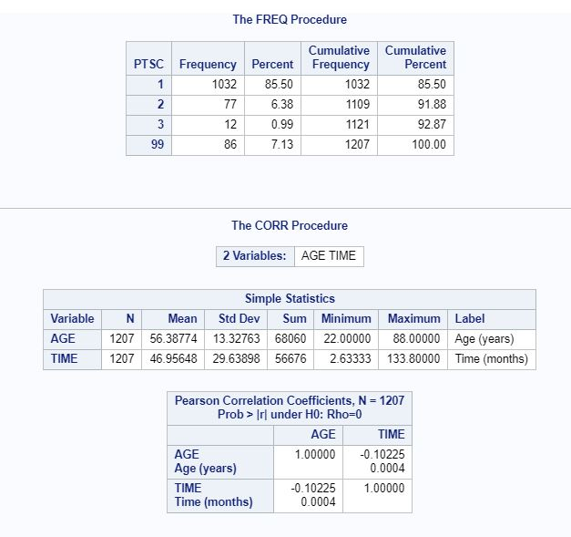
9. Correlation Between Age and Time
Here, age and time has weak negative correlation.

Slide 11
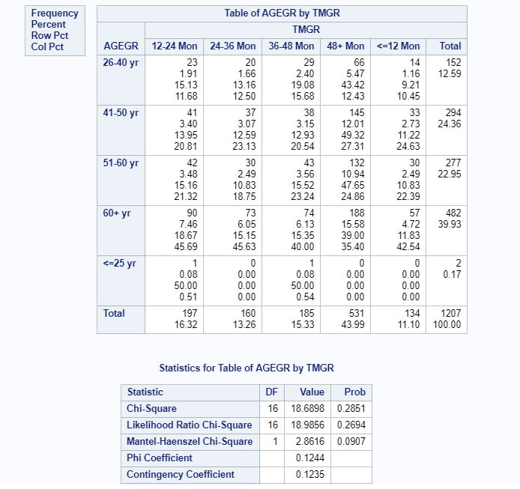
10. Chi-square Test of AGEGR and TIMEGR
Here, p value is <0.05. So, there is a significant difference between mean of AGEGR and TIMEGR. So, they are bad fit for the model.

Slide 12
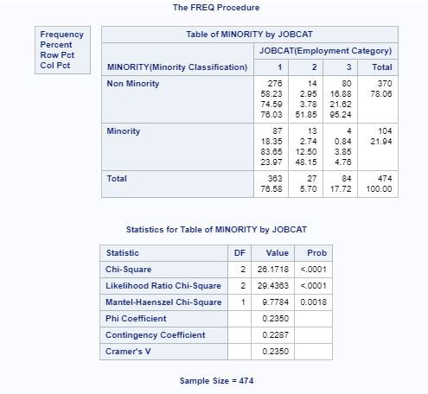
11.a. Chi-square Test of Minority and Jobcat
Here, p value is <0.05. So, Minority and Jobcat are bad fit.

Slide 13
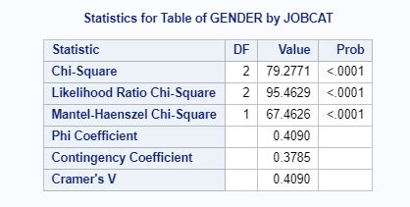
11.b. Chi-square Test of Gender and Jobcat
Here, p value is <0.05. So, Gender and Jobcat are bad fit.

Slide 14
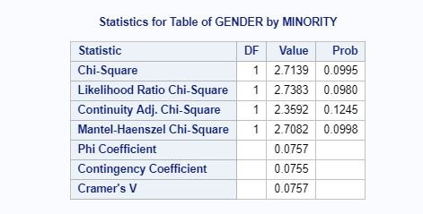
11.c. Chi-square Test of Gender and Minority
Here, p value is >0.05. So, Gender and Minority are good fit.

Slide 15
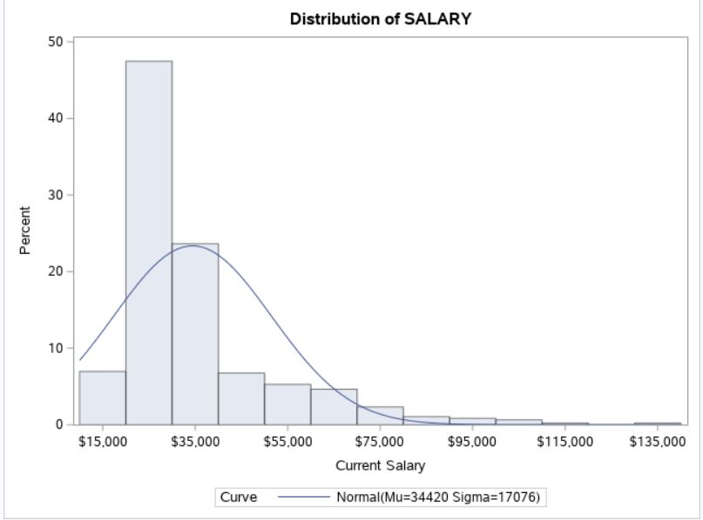
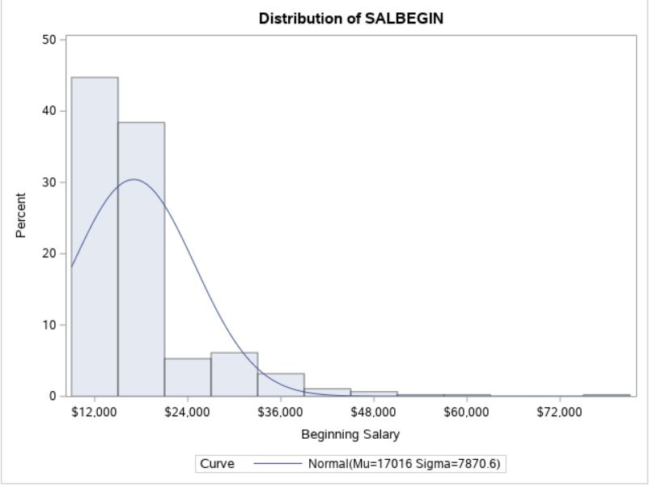
12. Histogram by Normal Curve of Increase (Current Salary – Begin Salary)

Slide 16
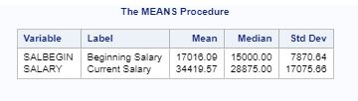
13. Mean, Median and Standard Deviation of Begin and Current Salary

Slide 17
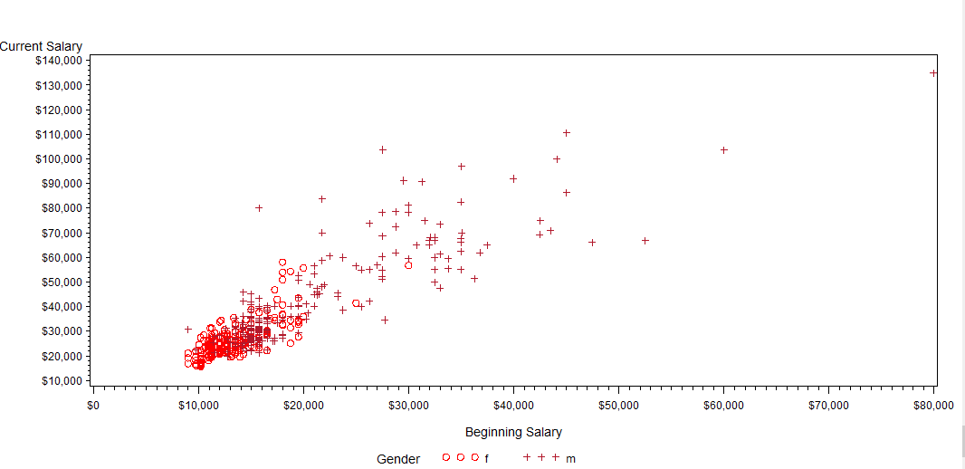
14. Scatter Plot : Current Salary and Begin Salary by set marks GENDER

Slide 18
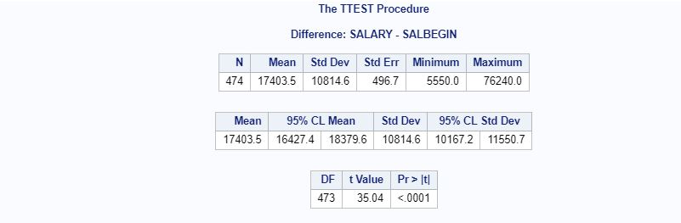
15. Paired Sample T-Test on Salary and Salbegin variable
Here, p value is <0.05. So, the mean average difference of two variables is significantly different from zero.

Slide 19
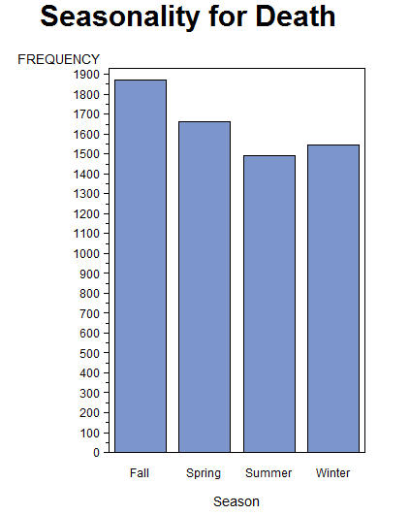
16. Seasonality for Death

Slide 20
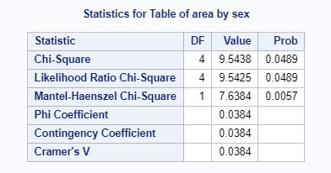
17. Chi-square Test of Area and Sex
Here, p value is <=0.05. So, Area and Sex are bad fit.

Slide 21
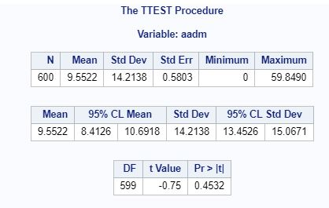
18.a. t Test – One sample t-test on Age at Death in month (AADM)
Here, p value is >0.05. So, there is no significant difference between sample and population mean of AADM.

Slide 22
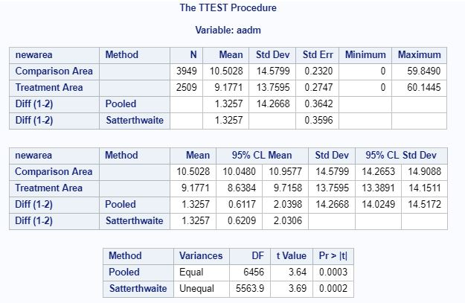
18.b. Independent sample t-test on AADM variable by Area
Here, p value is <0.05. So, there is significant difference between mean of AADM of comparison area and treatment area.

Slide 23
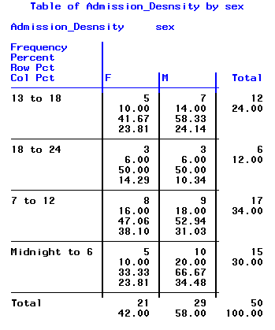
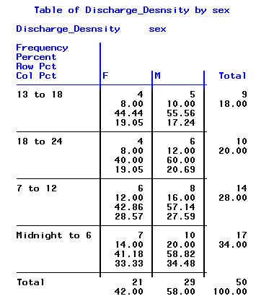
19.Macro reflecting Hospital Patient’s Density

Slide 24
THANK YOU

